Slide 1
CP Unit I
Introduction to Computer Programming

Slide 2
Outline of Topics
Hardware/Software interface
  Layers of the Machine
  Kinds of Software
Computer Languages
Syntax, Semantics, Grammars
What happens to your program?
  Compilation, Linking, Execution
  Program errors
Compilation vs. Interpretation etc.

Slide 3
Software Categories
System SW
  Programs written for computer systems
    Compilers, operating systems, …
Application SW
  Programs written for computer users
    Word-processors, spreadsheets, & other application packages

Slide 4
A Layered View of the Computer
Application Programs
Word-Processors, Spreadsheets,
Database Software, IDEs,
etc…
System Software
Compilers, Interpreters,Preprocessors, etc.
Operating System, Device Drivers
Machine with all its hardware

Slide 5
Operating System (OS)
Provides several essential services:
  Loading & running application programs
  Allocating memory & processor time
  Providing input & output facilities
  Managing files of information

Slide 6
Programs
Programs are written in programming languages
  PL = programming language
  Pieces of the same program can be written in different PLs
    Languages closer to the machine can be more efficient
    As long as they agree on how to communicate
A PL is
  A special purpose and limited language
  A set of rules and symbols used to construct a computer program
  A language used to interact with the computer

Slide 7
Computer Languages
Machine Language
  Uses binary code
  Machine-dependent
  Not portable
Assembly Language
  Uses mnemonics
  Machine-dependent
  Not usually portable
High-Level Language (HLL)
  Uses English-like language
  Machine independent
  Portable (but must be compiled for different platforms)
  Examples: Pascal, C, C++, Java, Fortran, . . .

Slide 8
Machine Language
The representation of a computer program which is actually read and understood by the computer.
  A program in machine code consists of a sequence of machine instructions.
Instructions:
  Machine instructions are in binary code
  Instructions specify operations and memory cells involved in the operation
Example:
Operation | Address
0010 | 0000 0000 0100
0100 | 0000 0000 0101
0011 | 0000 0000 0110

Slide 9
Assembly Language
A symbolic representation of the machine language of a specific processor.
Is converted to machine code by an assembler.
Usually, each line of assembly code produces one machine instruction (One-to-one correspondence).
Programming in assembly language is slow and error-prone but is more efficient in terms of hardware performance.
Mnemonic representation of the instructions and data
Example:
  Load Price
  Add Tax
  Store Cost

Slide 10
High-level language
A programming language which use statements consisting of English-like keywords such as "FOR", "PRINT" or “IF“, ... etc.
Each statement corresponds to several machine language instructions (one-to-many correspondence).
Much easier to program than in assembly language.
Data are referenced using descriptive names
Operations can be described using familiar symbols
Example:
Cost := Price + Tax

Slide 11
Syntax & Semantics
Syntax:
  The structure of strings in some language. A language's syntax is described by a grammar.
  Examples:
    Binary number
      <binary_number> = <bit> | <bit> <binary_number>
      <bit> = 0 | 1
    Identifier
      <identifier> = <letter> {<letter> | <digit> }
      <letter> = a | b | . . . | z
      <digit = 0 | 1 | . . . | 9
Semantics:
  The meaning of the language

Slide 12
Syntax & Grammars
Syntax descriptions for a PL are themselves written in a formal language.
  E.g. Backus-Naur Form (BNF)
The formal language is not a PL but it can be implemented by a compiler to enforce grammar restrictions.
Some PLs look more like grammar descriptions than like instructions.

Slide 13
Compilers & Programs
Compiler
  A program that converts another program from some source language (or high-level programming language / HLL) to machine language (object code).
  Some compilers output assembly language which is then converted to machine language by a separate assembler.
  Is distinguished from an assembler by the fact that each input statement, in general, correspond to more than one machine instruction.

Slide 14
Compilation into Assembly L
Assembly Language
Source
Program
Compiler
Assembly Language
Machine
Language
Assembler
Notes:
Instead of to ML
Facilitates debugging
Isolates compiler from changes in format of ML (new OS)
Only assembler must be changed!

Slide 15
Compilers & Programs
Source program
  The form in which a computer program, written in some formal programming language, is written by the programmer.
  Can be compiled automatically into object code or machine code or executed by an interpreter.
  Pascal source programs have extension ‘.pas’

Slide 16
Compilers & Programs
Object program
  Output from the compiler
  Equivalent machine language translation of the source program
  Files usually have extension ‘.obj’
Executable program
  Output from linker/loader
  Machine language program linked with necessary libraries & other files
  Files usually have extension ‘.exe’

Slide 17
What is a Linker?
A program that pulls other programs together so that they can run.
Most programs are very large and consist of several modules.
Even small programs use existing code provided by the programming environment called libraries.
The linker pulls everything together, makes sure that references to other parts of the program (code) are resolved.

Slide 18
Running Programs
Steps that the computer goes through to run a program:
Memory
Machine language program (executable file)
C P U
Input Data
Data entered during execution
Computed results
Program Output

Slide 19
Program Execution
Steps taken by the CPU to run a program (instructions are in machine language):
  Fetch an instruction
  Decode (interpret) the instruction
  Retrieve data, if needed
  Execute (perform) actual processing
  Store the results, if needed

Slide 20
Program Errors
Syntax Errors:
  Errors in grammar of the language
Runtime error:
  When there are no syntax errors, but the program can’t complete execution
    Divide by zero
    Invalid input data
Logical errors:
  The program completes execution, but delivers incorrect results
  Incorrect usage of parentheses

Slide 21
Compilation
Source
Program
Compiler
Target
Program
Input
Target Program
Output
Compiler translates source into target (a machine language program)
Compiler goes away at execution time
Compiler is itself a machine language program, presumably created by compiling some other high-level program
Machine language, when written in a format understood by the OS is object code

Slide 22
Interpretation
Source
Program
Interpreter
Output
Input
The interpreter stays around during execution
It reads and executes statements one at a time

Slide 23
Compilation vs. Interpretation
Compilation:
  Syntax errors caught before running the program
  Better performance
  Decisions made once, at compile time
Interpretation:
  Better diagnostics (error messages)
  More flexibility
  Supports late binding (delaying decisions about program implementation until runtime)
    Can better cope with PLs where type and size of variables depend on input
  Supports creation/modification of program code on the fly (e.g. Lisp, Prolog)

Slide 24
Mixture of C & I
Source
Program
Translator
Intermediate
Program
Intermediate
Program
VM
Output
Input
Many programming languages implement this
Interpreter implements a Virtual Machine (VM).

Slide 25
JAVA
  For portability:
Java
Compiler
bytecode
ML
Interpreter
  For flexibility: Just In Time (JIT) compiler translates bytecode into ML just before execution

Slide 26
Why Programming?
There are at least three good reasons for learning programming:
Programming helps you understand computers. The computer is only a tool. If you learn how to write simple programs, you will gain more knowledge about how a computer works.

Slide 27
2. Writing a few simple programs increases your confidence level. Many people find great personal satisfaction in creating a set of instructions that solve a problem.
3. Learning programming lets you find out quickly whether you like programming and whether you have the analytical turn of mind programmers need. Even if you decide that programming is not for you, understanding the process certainly will increase your appreciation of what programmers and computers can do.

Slide 28
The Programming Process
Developing a program involves steps similar to any problem-solving task. There are five main ingredients in the programming process:
Defining the problem
Planning the solution
Coding the program
Testing the program
Documenting the program

Slide 29
1. Defining the Problem
Suppose that, as a programmer, you are contacted because your services are needed.
You meet with users from the client organization to analyze the problem, or you meet with a systems analyst who outlines the project.
Specifically, the task of defining the problem consists of identifying what it is you know (input-given data), and what it is you want to obtain (output-the result).

Slide 30
Eventually, you produce a written agreement that, among other things, specifies the kind of input, processing, and output required. This is not a simple process.

Slide 31
2. Planning the Solution
Two common ways of planning the solution to a problem are to draw a flowchart and to write pseudocode, or possibly both.
Essentially, a flowchart is a pictorial representation of a step-by-step solution to a problem.
It consists of arrows representing the direction the program takes and boxes and other symbols representing actions.

Slide 32
It is a map of what your program is going to do and how it is going to do it.
The American National Standards Institute (ANSI) has developed a standard set of flowchart symbols.
Figure 1 shows the symbols and how they might be used in a simple flowchart of a common everyday act-preparing a letter for mailing.

Slide 33
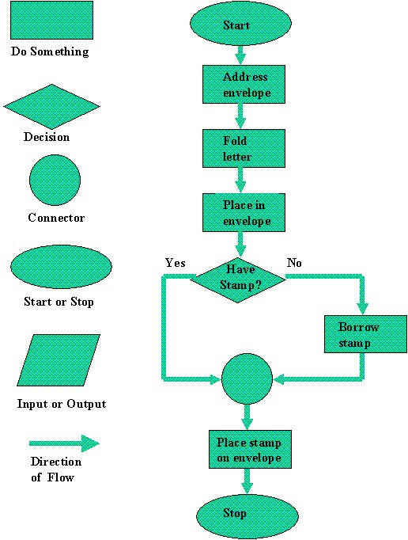

Slide 34
Pseudocode is an English-like nonstandard language that lets you state your solution with more precision than you can in plain English but with less precision than is required when using a formal programming language.
Pseudocode permits you to focus on the program logic without having to be concerned just yet about the precise syntax of a particular programming language.

Slide 35
3. Coding the Program
As the programmer, your next step is to code the program-that is, to express your solution in a programming language.
You will translate the logic from the flowchart or pseudocode-or some other tool-to a programming language.
As we have already noted, a programming language is a set of rules that provides a way of instructing the computer what operations to perform.

Slide 36
There are many programming languages: BASIC, COBOL, Pascal, FORTRAN, and C are some examples.

Slide 37
4. Testing the Program
Some experts insist that a well-designed program can be written correctly the first time.
In fact, they assert that there are mathematical ways to prove that a program is correct.
However, the imperfections of the world are still with us, so most programmers get used to the idea that their newly written programs probably have a few errors.

Slide 38
This is a bit discouraging at first, since programmers tend to be precise, careful, detail-oriented people who take pride in their work.
Still, there are many opportunities to introduce mistakes into programs, and you, just as those who have gone before you, will probably find several of them.

Slide 39
Step - Testing
Desk-checking.
    This phase, similar to proofreading, is sometimes avoided by the programmer who is looking for a shortcut and is eager to run the program on the computer once it is written.
Translating
  (1) checks the syntax of your program
  (2) then translates your program into a form the computer can understand.

Slide 40
Debugging
  debugging means detecting, locating, and correcting bugs (mistakes), usually by running the program.
  These bugs are logic errors, such as telling a computer to repeat an operation but not telling it how to stop repeating.

Slide 41
5. Documenting the Program
Documenting is an ongoing, necessary process, although, as many programmers are, you may be eager to pursue more exciting computer-centered activities.
Documentation is a written detailed description of the programming cycle and specific facts about the program.

Slide 42
Typical program documentation materials include the origin and nature of the problem, a brief narrative description of the program, logic tools such as flowcharts and pseudocode, data-record descriptions, program listings, and testing results.

